Slide 1
BuyRight
“Will this work for me?” A personal, cited fit check on the product page, so shoppers buy once and don't return.
Ashokkumar · AI PM course project · 8 November 2026 · concept for Amazon.in, built on synthetic data

Slide 2
The product works. It just doesn't work for this shopper.
8–15%
10–20%
20–65%
1.8–2.3x
of electronics and accessories orders are returned; ‘not as expected’ is a primary reason
return rate for home and furniture, where size and fit decide everything
of an item's value is spent processing one return
more returns on COD orders than prepaid, and COD is 50–60% of orders in tier-2/3 cities
A 1-ton AC in a 180 sq ft top-floor room in Jaipur. A 25 W charger for a phone that wants 45 W. A 30 cm-deep rack for size-10 shoes.
Every one of these mismatches is visible on the listing before purchase, if someone does the maths.
Figures from the project brief (returns in India, COD behaviour, return processing cost).

Slide 3
Discovery: shoppers look for ‘someone like me’
PRIMARY PERSONA
“I read 400 reviews and still couldn't tell if 1 ton is enough for our top floor.”
Neha, 34, accounts executive, Lucknow (tier-2)
Neha, Lucknow
Buying her family's first split AC for a 180 sq ft top-floor bedroom, budget ₹40,000.
Shops on her phone in the evening. Reads specs she can't map to her room, searches reviews for her city, asks in Q&A and waits days.
Picks COD ‘just in case’. Over-buys capacity or abandons the cart.
“The box says fast charging, my phone says charging slowly.”
Arjun, Indore
“It said 12 pairs. With my husband's shoes it holds eight.”
Interviewee 3
“I choose cash on delivery when I'm not sure. Then I can refuse it.”
Interviewee 5
Persona, quotes and interview counts are synthetic, made up for this course project.

Slide 4
Five whys: the facts exist, the verdict doesn't
1
2
3
4
5
Returned
Missed it
Not personal
Can't do the maths
Business cost
Product works, but not in her room, with her phone, in her space.
Deal-breakers are scattered in specs and buried in reviews.
Pages and chat answers are written for an average buyer.
She doesn't know which question to ask: tons per sq ft, PD vs PPS, shelf depth.
Abandoned carts, COD as an exit, returns at 20–65% of item value.
ROOT CAUSE
Shoppers can't check, before paying, whether a product will work in their own situation. The deciding facts are on the page and in reviews, but nothing turns them into a personal, cited verdict.

Slide 5
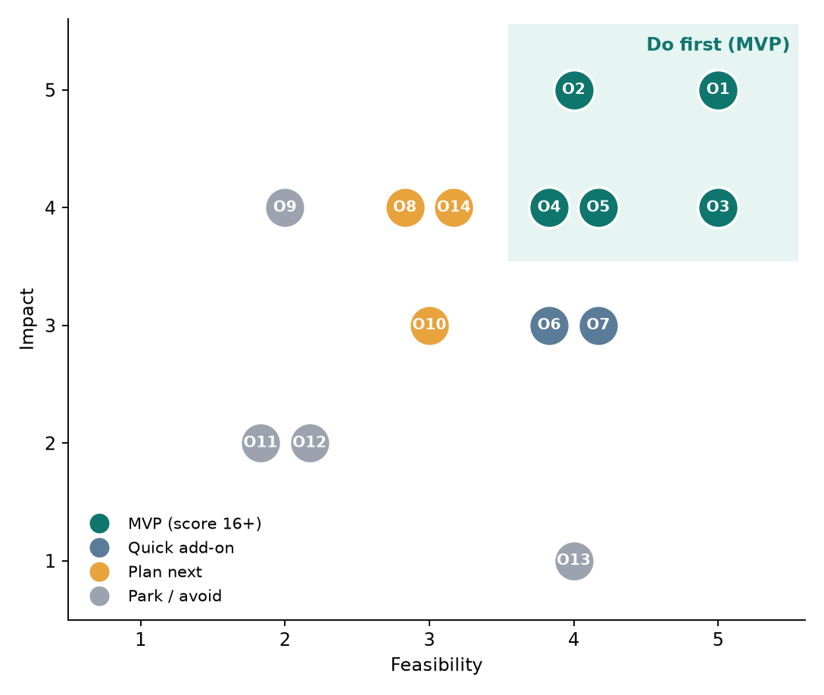
Where AI helps, and where it must not decide
MVP
O1 Fit verdict by rules · O2 Owners like me · O3 Cited explanation · O4 Ask my situation · O5 Fit-safe alternatives
Next
O6 Seller missing-spec alerts · O7 Install checklist · O8 Learn rules from returns · O14 Hindi and voice
Parked
O9 Camera measuring · O11 Is this deal real? · O12 AI-filled specs (would invent facts) · O13 Persuasive sales bot (destroys trust)
Key decision: the verdict is a written rule, not a model. AI finds and explains; it never decides.
Full map with 8 journey stages, 14 opportunities, scoring and guardrails: 2. AI Opportunity Mapping - BuyRight.xlsx and the Miro import CSV.

Slide 6
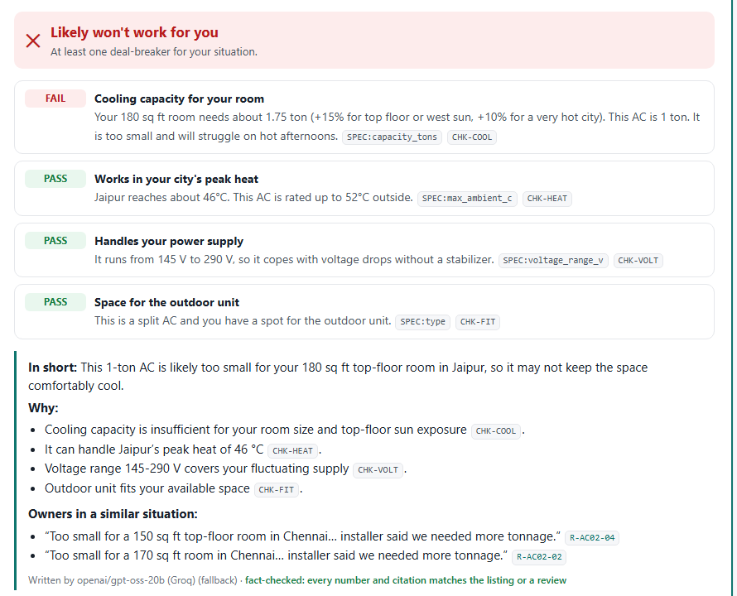
BuyRight: answer 2–5 questions, get a verdict with sources
1 Ask only what decides fit
Room size and city; phone model; space and shoe size. Presets for speed. Answers stay on the phone.
2 Rules give the verdict
Works · Works with a caveat · Likely won't work · Need more info. Each check shows its numbers and the spec it used.
3 AI explains, with citations
Plain language, every claim cites a check, spec or review; reviews from owners in a similar situation.
4 If not, what does fit
Up to 3 same-category products that pass the same checks, ranked by rating, never sponsored.

Slide 7
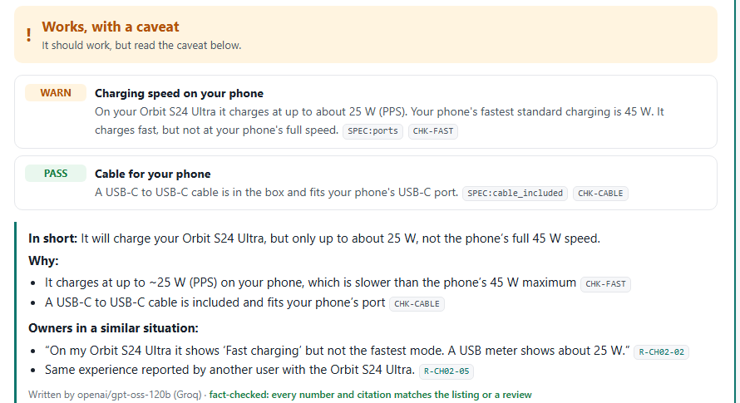
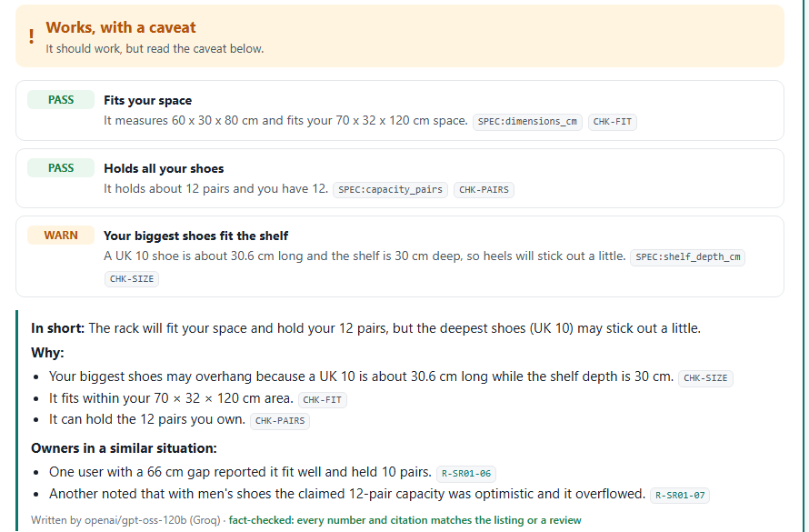
Three situations, three honest answers
Charger, Orbit S24 Ultra: works, with a caveat. About 25 W of the phone's 45 W. Owners with the same phone said the same. The 45 W model is offered as the fit.
Shoe rack, 70 cm alcove, UK 10: fits the space and holds 12 pairs, but a 30.6 cm shoe on a 30 cm shelf will stick out a little.

Slide 8
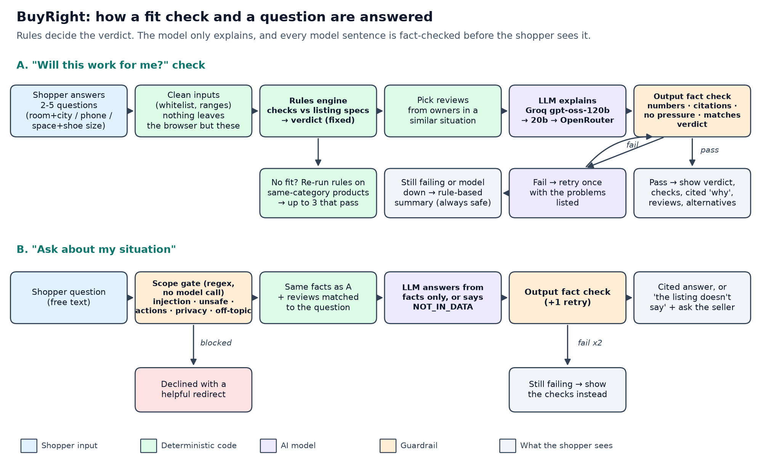
Rules decide. AI explains. Every sentence is fact-checked.
Models (free tiers): Groq openai/gpt-oss-120b → Groq openai/gpt-oss-20b → OpenRouter google/gemma-4-31b-it:free. The answering model is shown on every result.

Slide 9
Guardrails: built for a buy decision, not a chat
Wrong ‘Works’
Conservative written thresholds, a caveat band, property test: a failed check can never show as Works
Invented numbers or specs
Every number and citation in model text must exist in the facts; one retry; else rule-based summary
Contradicting the verdict
Model can't change the verdict; text that says ‘will work’ on a mismatch is rejected
Pressure or false certainty
‘Buy now’, ‘guaranteed’, urgency are blocked; no price or stock data in context
Injected or fake reviews
Reviews are data; a planted ‘IGNORE ALL INSTRUCTIONS’ review is in the eval set
Unsafe or off-scope asks
Wiring and earthing, gas, orders, returns, COD, reviewer details: declined before any model call
Missing data
‘Need more info’ or ‘the listing doesn't say’, never a guess

Slide 10
Evals: safety at 100%, quality targets met
Eval | Dev | Held-out | Target
Verdict correct (hand-labelled scenarios) | 41/41 | 18/18 | 95%+
Individual checks correct | 69/69 | 28/28 | 95%+
S1 A fail never shows as Works (3,000 random profiles) | 2057/2057 | — | 100%
S3 Scope gate declines / no false blocks | 18/18 / 15/15 | — | 100%
S4 Fact check catches bad text, accepts good | 12/12 | — | 100%
Explanations written by the model and fact-checked (live) | 41/41 | 17/18 | 90%+
Q&A answers contain the right facts (live) | 18/19 | 9/9 | 90%+
‘Not in data’ answered honestly (live) | 3/3 | 2/2 | 80%+
Declines and injected review handled safely (live) | 4/4 | 2/2 | 100%
Every model sentence a shopper saw passed the fact check (the one held-out explanation that said ‘it will fit’ while info was missing was blocked and replaced). Tokens per call: about 949 in, 205 out.
Run on 8 Nov 2026. Rules evals run on every deploy (npm test). Live evals call the real free-tier models; raw rows in evals/results/.

Slide 11
North Star: confident purchases
NORTH STAR
AI metrics
Grounded explanations 90%+ · safety gates 100% · verdict accuracy 95%+ · ‘Works’ later returned for mismatch under 2%
Orders not returned for a mismatch reason within 30 days
Product metrics
15%+ of visitors in the 3 categories run a check · 70%+ ‘helpful’ · questions answered without seller Q&A
A/B test: BuyRight on product pages vs control, randomised by shopper, 6 weeks.
Primary: mismatch-return rate, target −25%.
Guardrails: conversion and add-to-cart flat or up.
Secondary: COD-to-prepaid shift, time to purchase.
Business metrics
Mismatch returns −25% · return cost avoided · COD share among checked orders down 5 pts
Cost metric
AI cost under ₹0.2 per check and under 1% of the return cost it avoids
Targets are illustrative for the course project.

Slide 12
Cost: about 2 paise a check vs ₹2,400 a return
~$0.0003
~₹1.4 lakh
~₹2.2 crore
per explanation on gpt-oss-120b (970 tokens in, 205 out, measured)
a month for about 6 million model calls (150k checks + 40k questions a day, illustrative)
a month of return cost avoided if mismatch returns fall 25% (illustrative)
What keeps it cheap: the verdict, retrieval, fact check and alternatives are code (no model cost); ‘Need more info’ and declined questions make no model call; the model sees about 1,000 tokens, not the catalogue.
Next lever: cache identical (product, answers) checks; a smaller model for explanations once the fact-check pass rate holds.
Prototype runs on free tiers. Paid list prices and all volumes are estimates; see 4. Cost Estimation - BuyRight.xlsx.

Slide 13
Rollout: earn trust in stages, with a kill switch
Alpha
Beta 1%
A/B 5%
Scale
Internal, 3 categories, real listings. Gate: safety 100%, verdict 95%+ on a fresh held-out set.
‘Was this helpful?’ on every result. Gate: zero safety incidents, 70%+ helpful, no conversion drop.
6 weeks for 30-day returns. Gate: mismatch returns down with significance; guardrails flat or up.
All traffic in 3 categories, then one new category at a time, each with its own rules and eval set.
KILL SWITCH: roll back immediately if
an invented number, guarantee or ‘buy now’ reaches a shopper · a failed check shows as Works, or ‘Works’ verdicts are returned for mismatch above 2%
conversion or add-to-cart falls more than 1% vs control for 3 days · any injection or privacy incident

Slide 14
What I'd like from you
1. Approve an internal alpha
Three categories, real listings, a fresh held-out set of 100 listings labelled by category managers.
2. Share return reason codes
Mismatch returns by product, so the North Star can be measured and new rules learned from them.
3. Fix listing gaps
Sellers asked for the fit-deciding specs BuyRight needs (ambient rating, voltage range, shelf depth).
Prototype, code, evals and all deliverables: see the repo README. All data is synthetic.

